Slide 1

Automation Testing
By- Manas

Slide 2
HANDLING MULTIPLE WINDOWS
We are using this option to handle multiple windows in webdriver. Sometimes during run time, we need to work on multiple windows (more than 1 window). In that case we need to first count number of windows using “getWindowhandles” method and we can work on multiple windows.

Slide 3
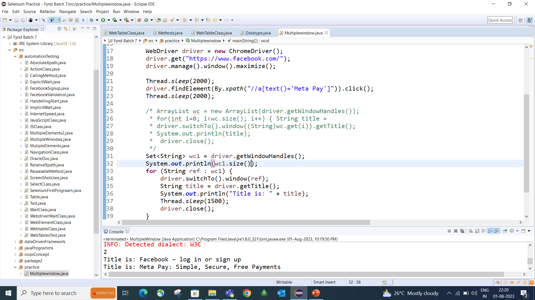

Slide 4
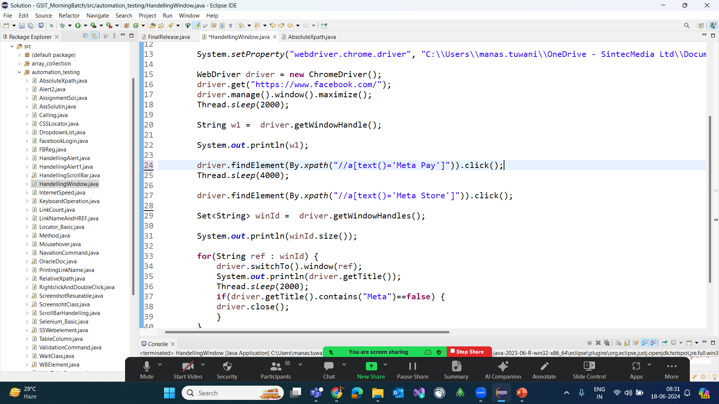

Slide 5
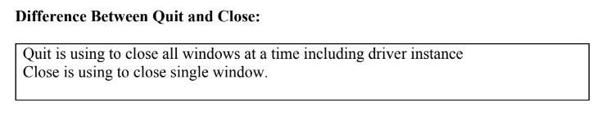

Slide 6
FAQ’s:
1. How to handle multiple windows in Web driver?
2. Prepare program to close all opened windows
3. Diff between close() and quit() method
4. Diff between getWindowHandle() and getWindowHandles() method.
4. Prepare program to close only window which title contains “Sample”

